Slide 1
Machine Learning basic Algebra, Probability, and Stats
Dr. Malak Abdullah
Computer Science Department
Jordan University of Science and Technology

Slide 2
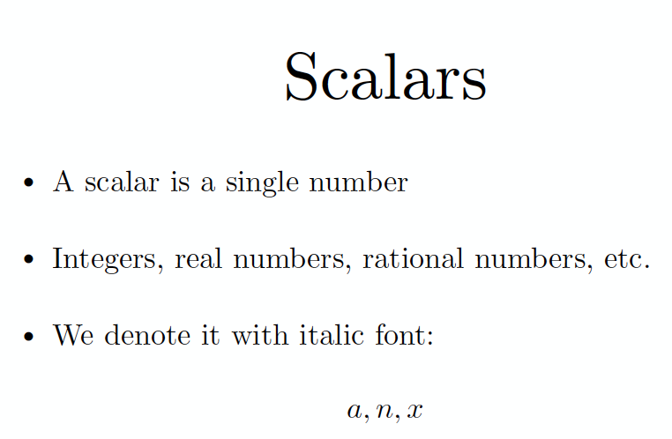

Slide 3
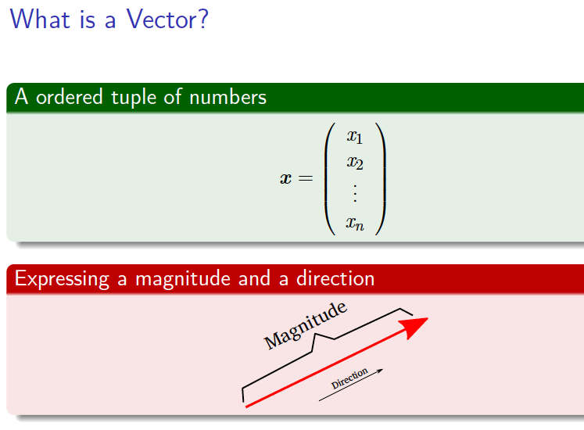
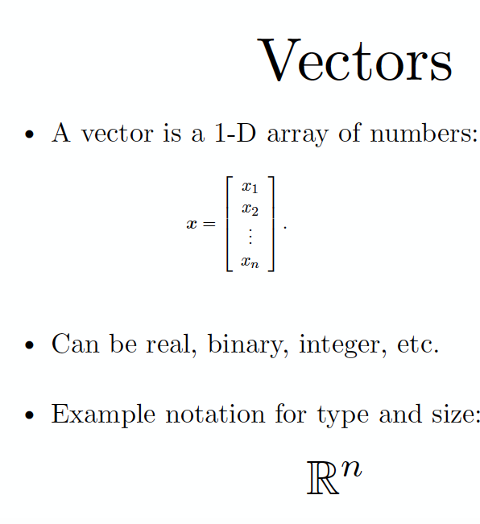

Slide 4
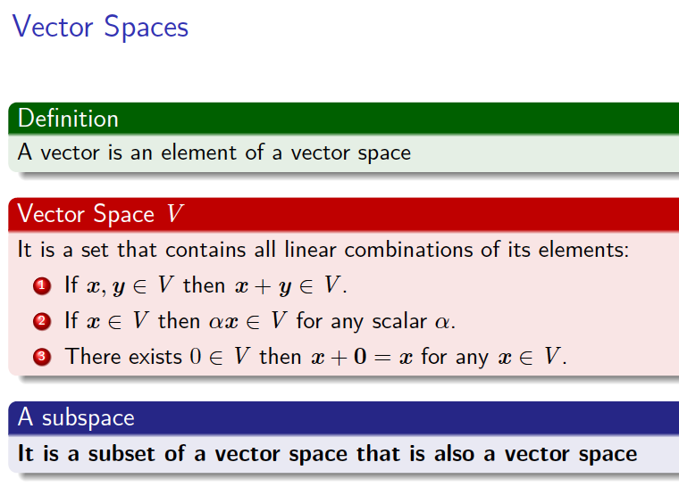

Slide 5
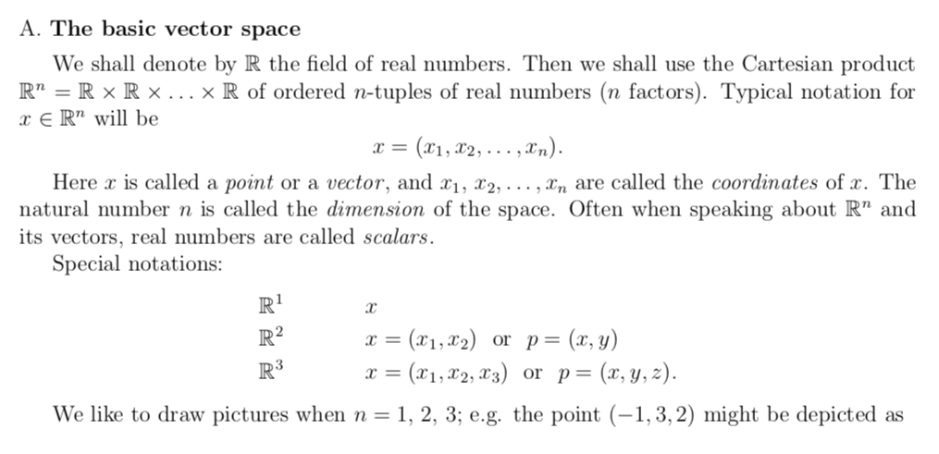

Slide 6
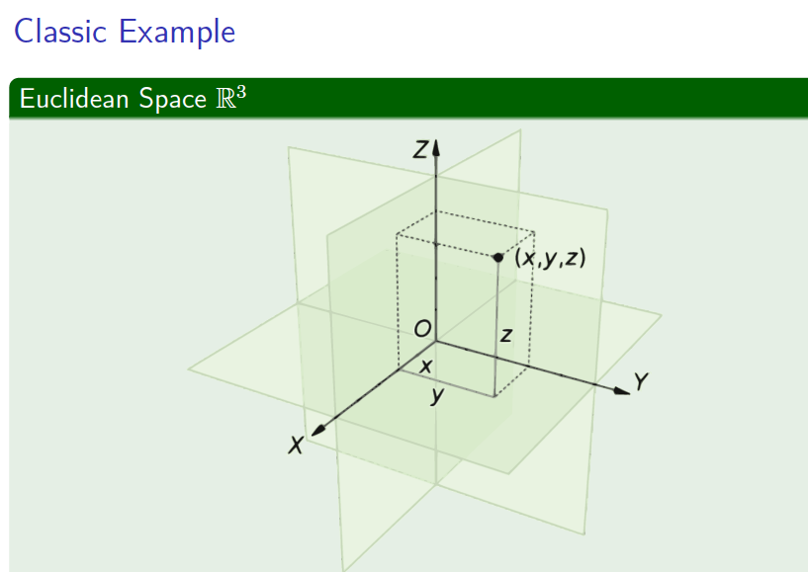

Slide 7
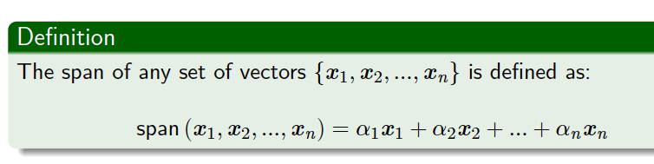
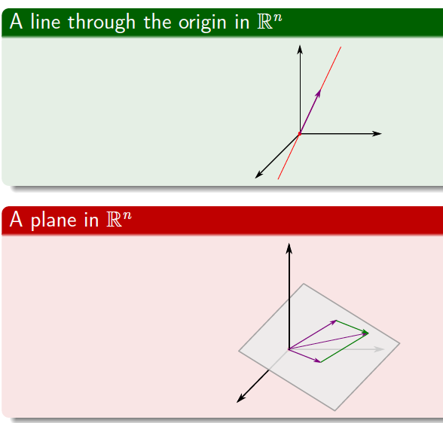
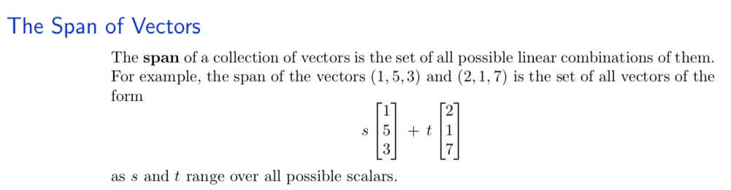
Span & Plane

Slide 8
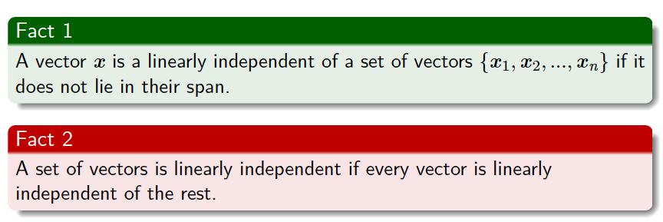

Slide 9
A good video for
Why Linear Algebra is important
https://www.youtube.com/watch?v=ozwodzD5bJM
https://www.youtube.com/watch?v=fNk_zzaMoSs&feature=youtu.be

Slide 10
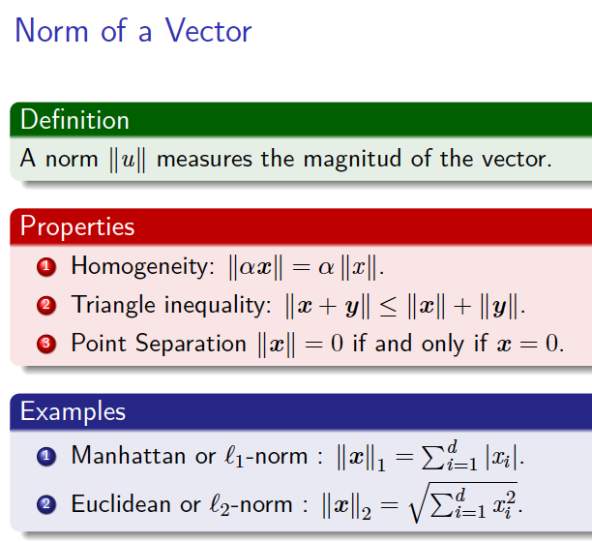
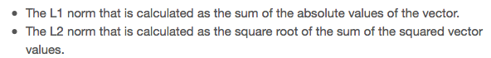
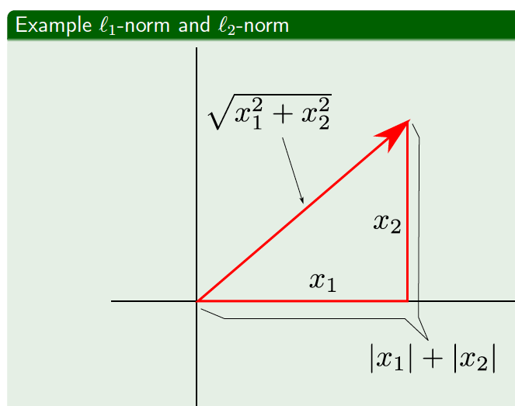

Slide 11
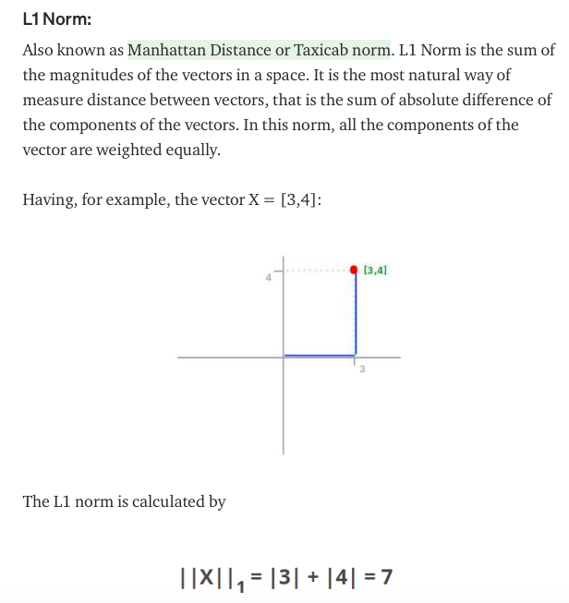
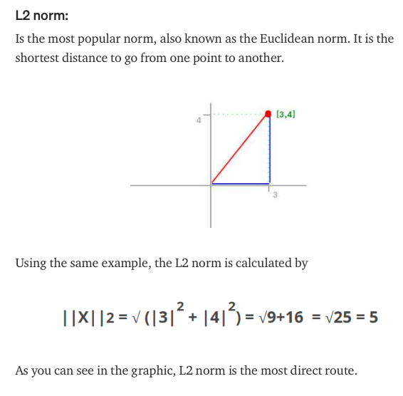

Slide 12
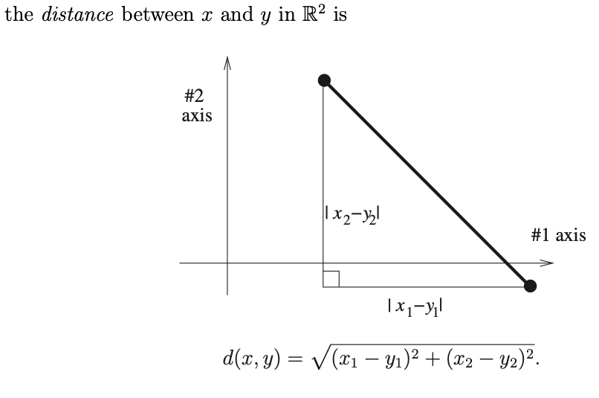

Slide 13
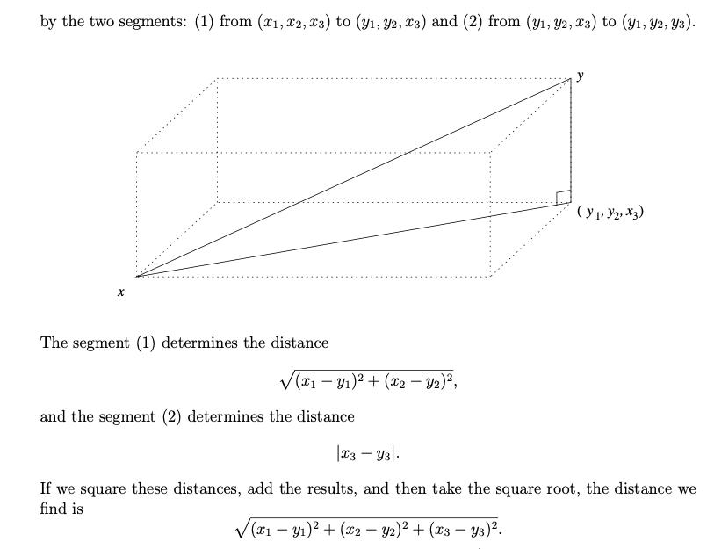

Slide 14
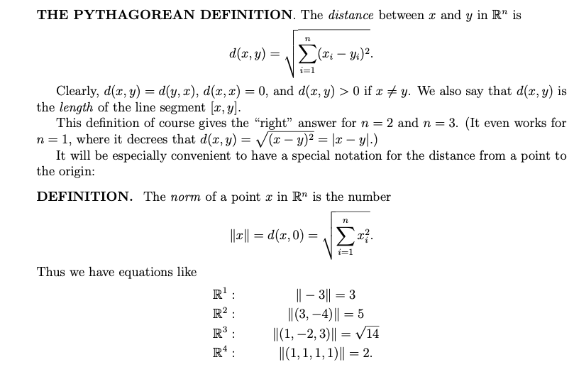

Slide 15
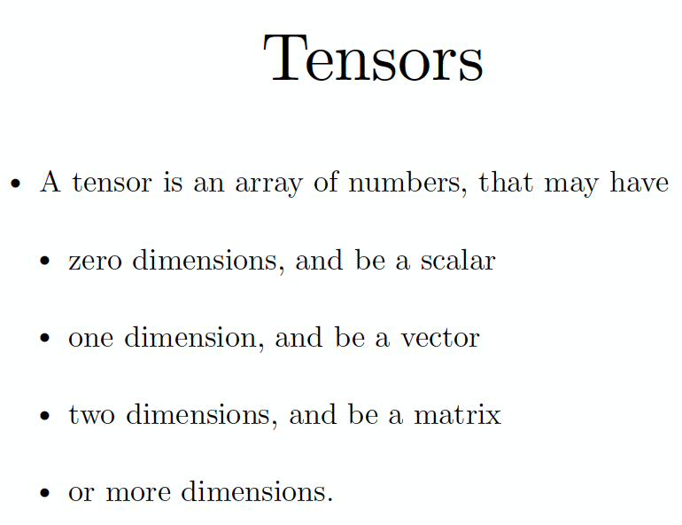

Slide 16
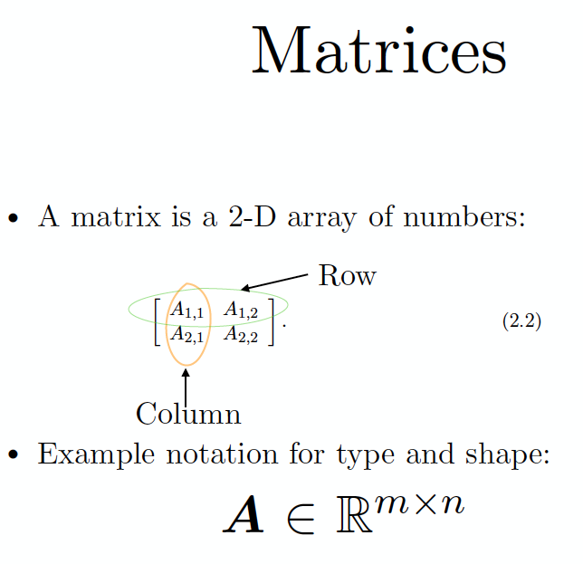
A matrix is a rectangular array of numbers organized in rows and columns
If a matrix A has m rows and n columns, then we say that A is an m x n matrix

Slide 17
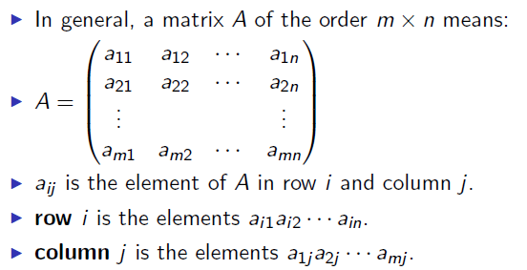
Matrix

Slide 18
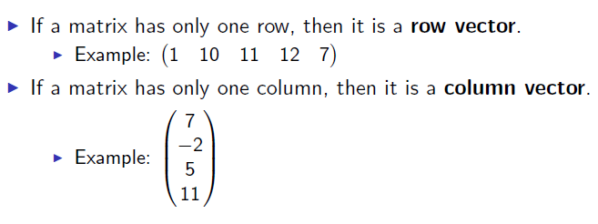
Vectors

Slide 19
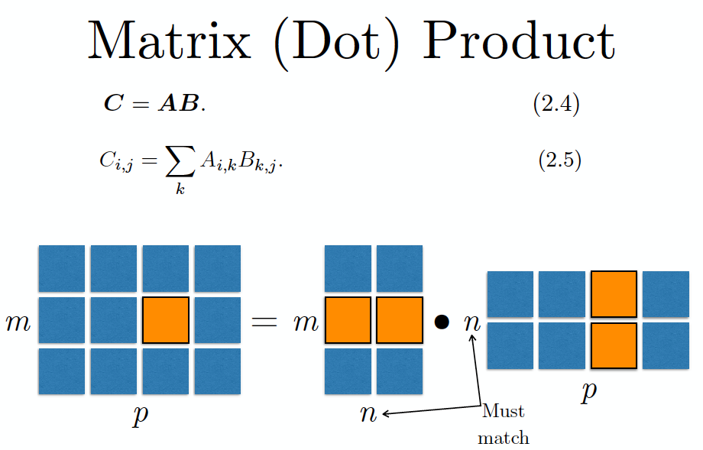

Slide 20
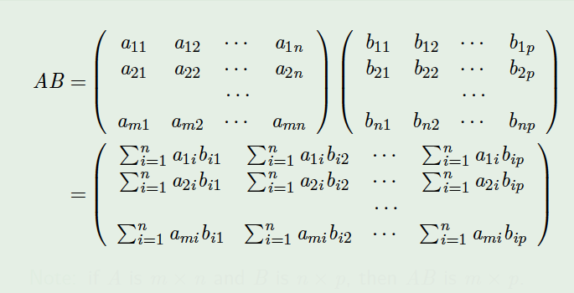
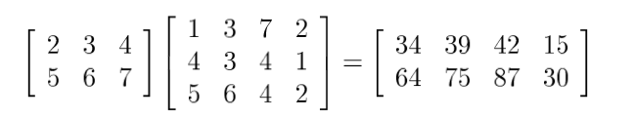
Multiplication of two matrices

Slide 21
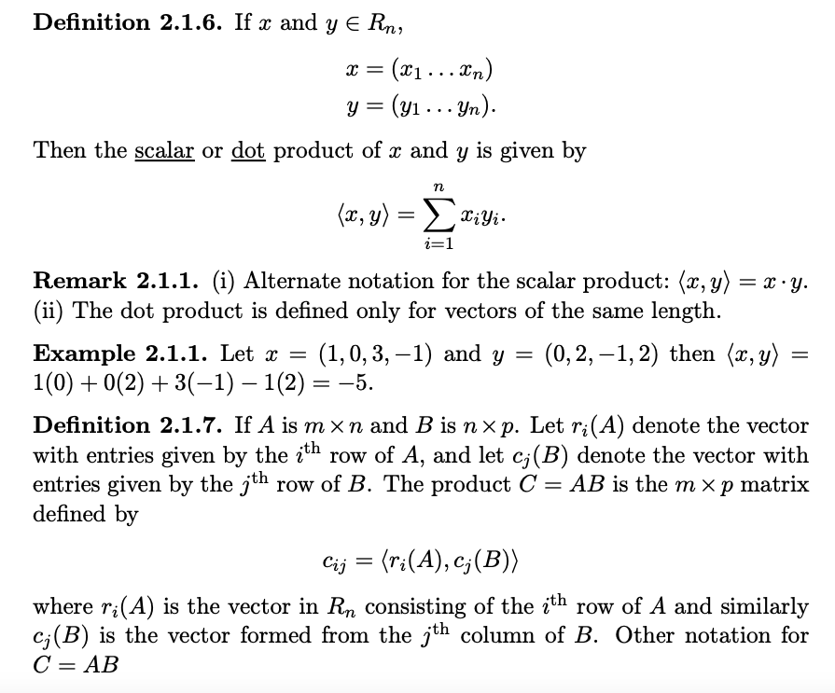

Slide 22
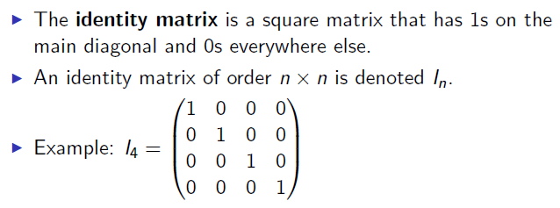
Identity matrix

Slide 23
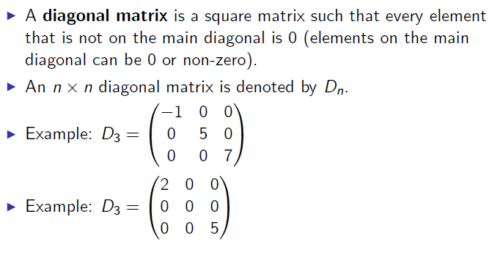
Diagonal matrix

Slide 24
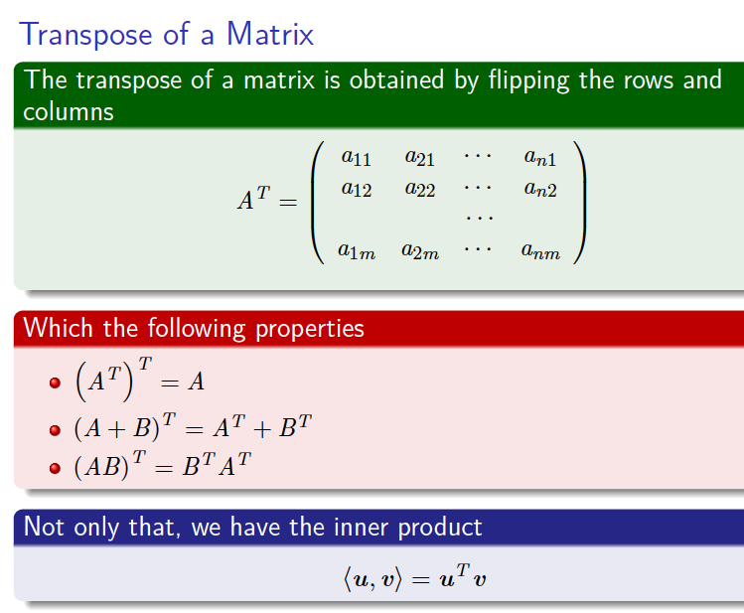
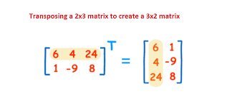

Slide 25
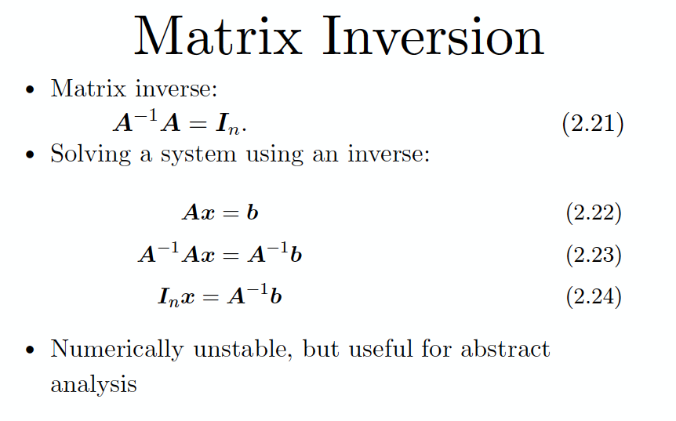
Inverse

Slide 26
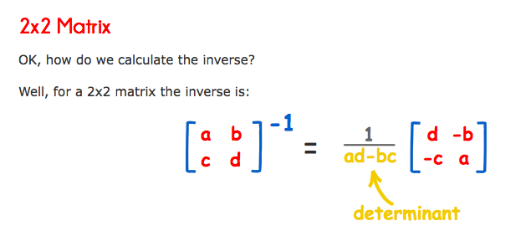
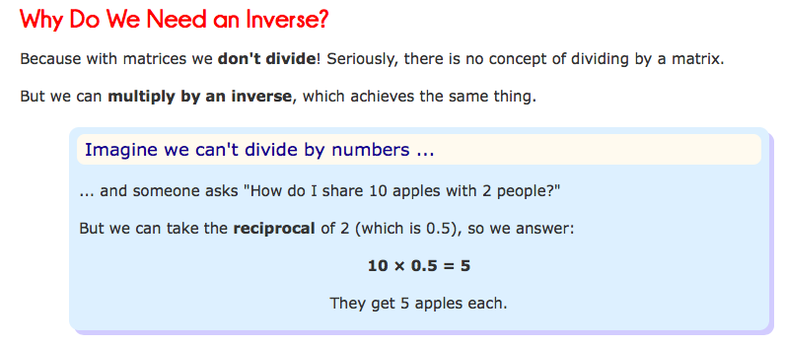

Slide 27
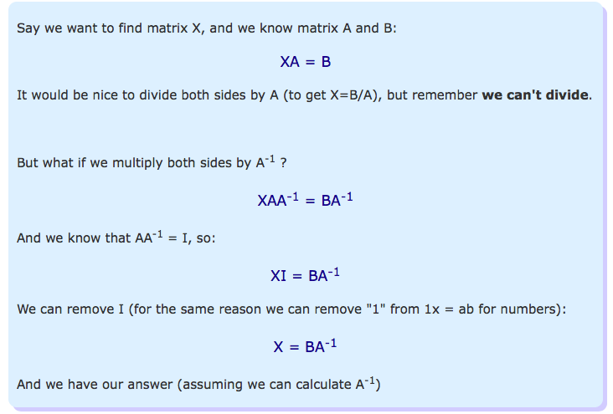

Slide 28
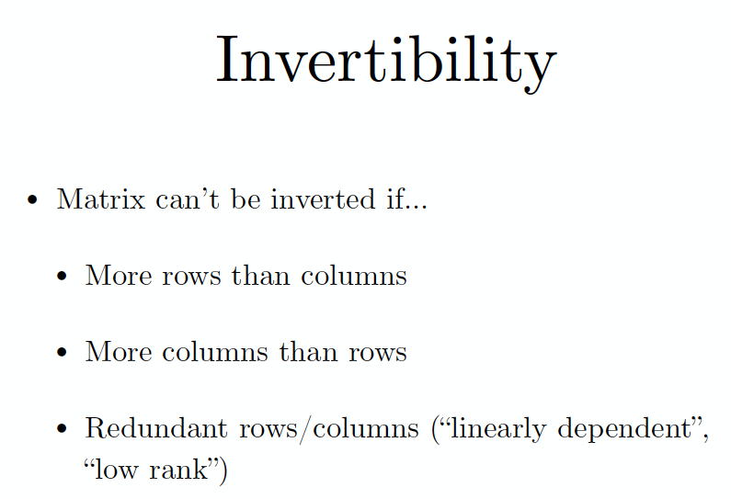

Slide 29
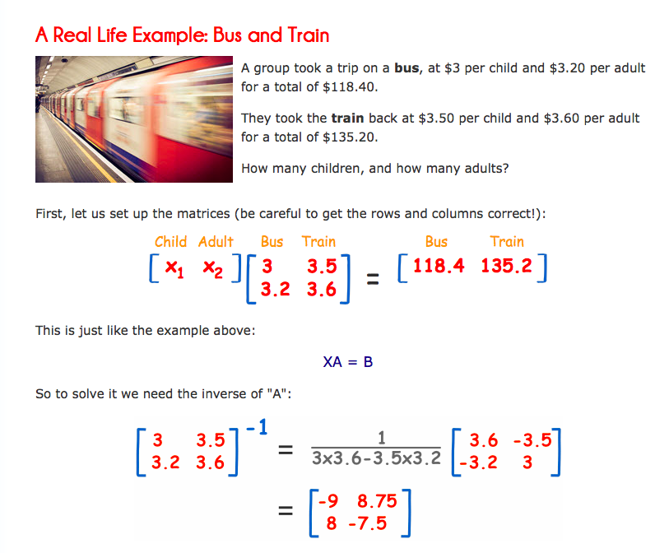
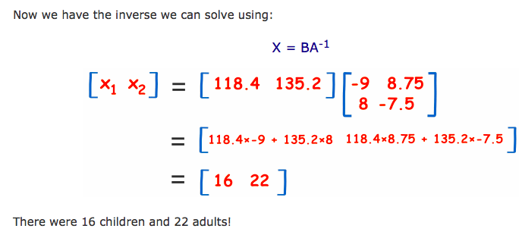

Slide 30
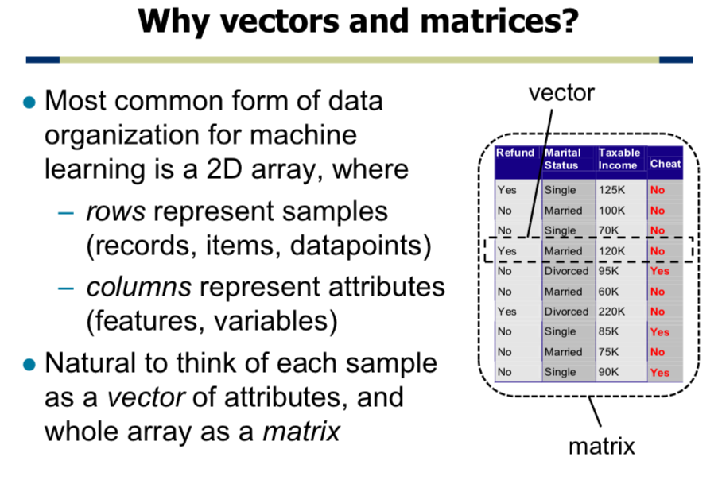

Slide 31
Numpy
Numpy array creation
Array access and operations
Basic linear algebra

Slide 32
Numpy
Stands for Numerical Python
an efficient multi-dimensional container for generic data
Is the fundamental package required for high performance computing and data analysis
It provides
ndarray for creating multiple dimensional arrays
Standard math functions for fast operations on entire arrays of data without having to write loops
Tools for reading/writing array data
Linear algebra tools
etc.

Slide 33
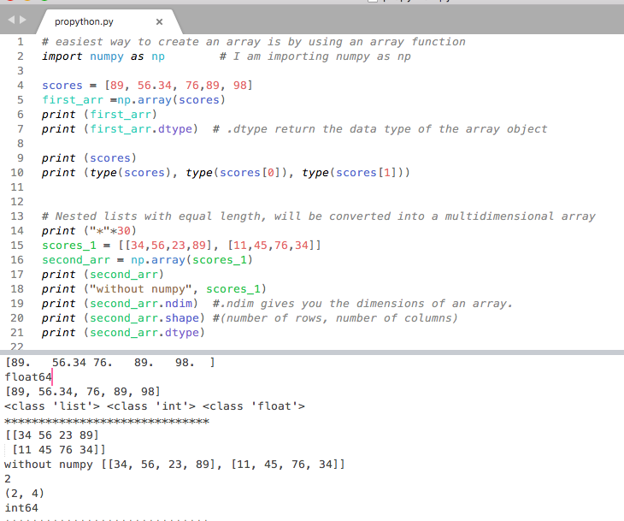

Slide 34
ndarray vs list of lists
gArray = np.array(examGrades)
In [5]: gArray[0,2]. # gArray[0][2]
Out[5]: 60
In [7]: gArray[2,:] #gArray[2]
Out[7]: array([99, 67, 84])
In [8]: gArray[:, 0]
Out[8]: array([79, 95, 99, 76, 91, 70, 88, 67, 82, 94])
In [9]: gArray[:3, :2]
Out[9]:
array([[79, 95],
[95, 60],
[99, 67]])
In [3]: gArray
Out[3]:
array([[79, 95, 60],
[95, 60, 61],
[99, 67, 84],
...,
[67, 73, 80],
[82, 89, 61],
[94, 67, 88]])

Slide 35
ndarray
ndarray is used for storage of homogeneous data
i.e., all elements must be the same type
Every array must have a shape and a dtype
Supports convenient slicing, indexing and efficient vectorized computation
Avoid for loops, and much more efficient
In [15]: type(gArray)
Out[15]: numpy.ndarray
In [16]: gArray.ndim
Out[16]: 2
In [17]: gArray.shape
Out[17]: (10, 3)
In [18]: gArray.dtype
Out[18]: dtype('int32')

Slide 36
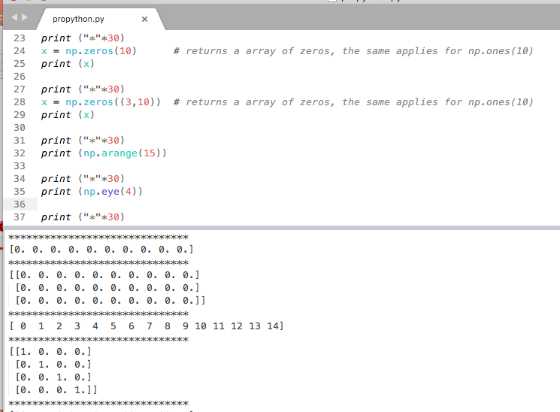

Slide 37
Creating ndarrays
In [69]: np.eye(3)
Out[69]:
array([[ 1., 0., 0.],
[ 0., 1., 0.],
[ 0., 0., 1.]])
In [70]: np.arange(0, 10, 2)
Out[70]: array([0, 2, 4, 6, 8])
In [65]: np.array([[0,1,2],[2,3,4]])
Out[65]:
array([[0, 1, 2],
[2, 3, 4]])
In [66]: np.zeros((2,3))
Out[66]:
array([[ 0., 0., 0.],
[ 0., 0., 0.]])
In [67]: np.ones((2,3))
Out[67]:
array([[ 1., 1., 1.],
[ 1., 1., 1.]])
np.array
np.zeros
np.ones
np.eye
np.arange
np.random
In [295]: np.random.randint(0, 10, (3,3))
Out[295]:
array([[8, 7, 6],
[0, 8, 9],
[9, 0, 4]])

Slide 38
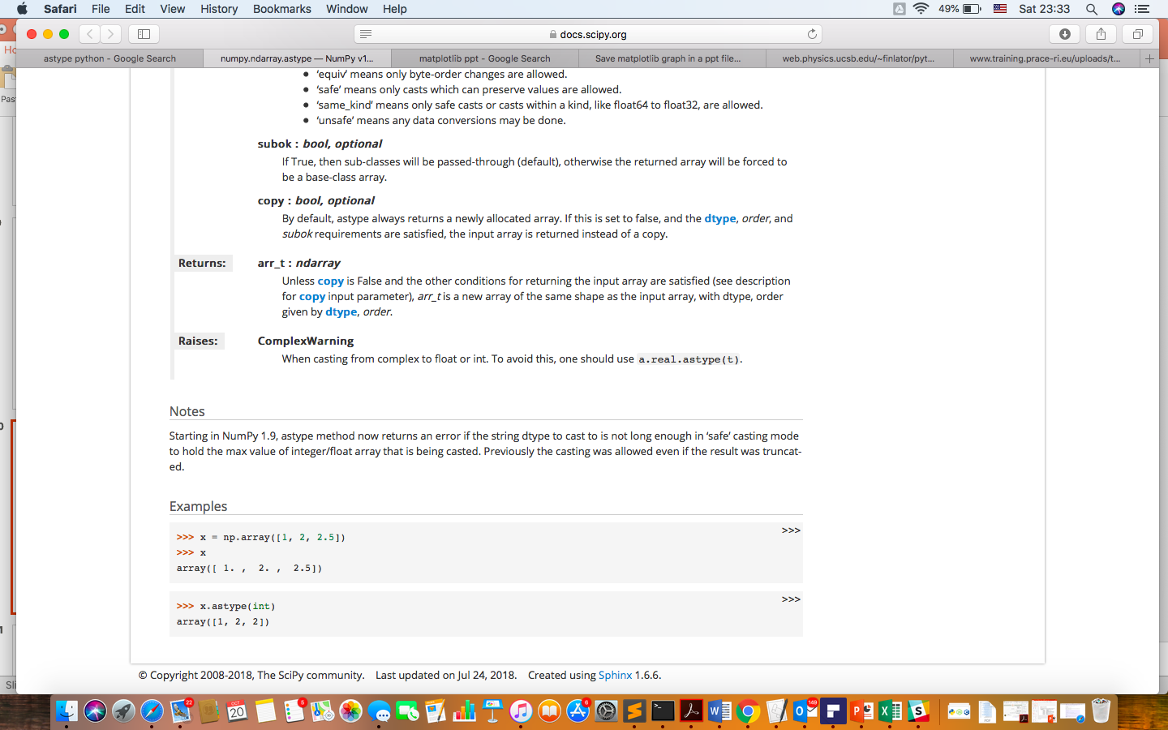
Numpy data types
In [34]: gArray.astype(float64)
Out[34]:
array([[ 79., 95., 60.],
[ 95., 60., 61.],
...,
[ 82., 89., 61.],
[ 94., 67., 88.]])
int8, int16, int32, int64
float16, float32, float64, float128
bool
object
String
Unicode
gArray.astype
64 bits
In [79]: num_string = array(['1.0', '2.05', '3'])
In [81]: num_string
Out[81]:
array(['1.0', '2.05', '3’], dtype='<U4')
In [82]: num_string.astype(float)
Out[82]: array([ 1. , 2.05, 3. ])

Slide 39
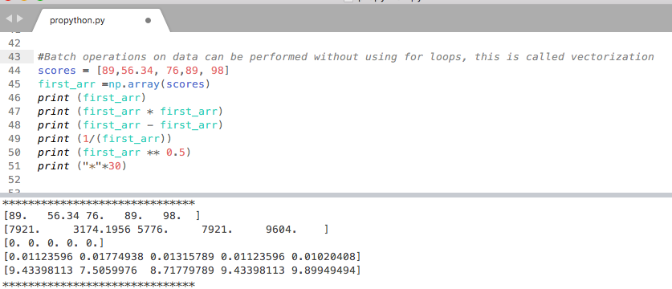

Slide 40
Array indexing and slicing (cont’d)
In [160]: gArray[:2, [0, 2]]
Out[160]:
array([[79, 60],
[95, 61]])
In [152]: gArray
Out[152]:
array([[79, 95, 60],
[95, 60, 61],
[99, 67, 84],
...,
[67, 73, 80],
[82, 89, 61],
[94, 67, 88]])
In [175]: gArray[[0, 2], :]
Out[175]:
array([[79, 95, 60],
[99, 67, 84]])
In [200]: gArray[[0,2]][:,[0,2]]
Out[200]:
array([[79, 60],
[99, 84]])

Slide 41
Array slices are views
In [202]: gArray[0,:]=100
In [203]: gArray
Out[203]:
array([[100, 100, 100],
[ 95, 60, 61],
[ 99, 67, 84],
...,
[ 67, 73, 80],
[ 82, 89, 61],
[ 94, 67, 88]])
In [254]: arr2 = gArray.copy()
In [255]: arr2 is gArray
Out[255]: False
In [258]: arr2[1,:]=100
In [260]: gArray[1,:]
Out[260]: array([95, 60, 61])
Use .copy() to make a copy of an array explicitly.

Slide 42
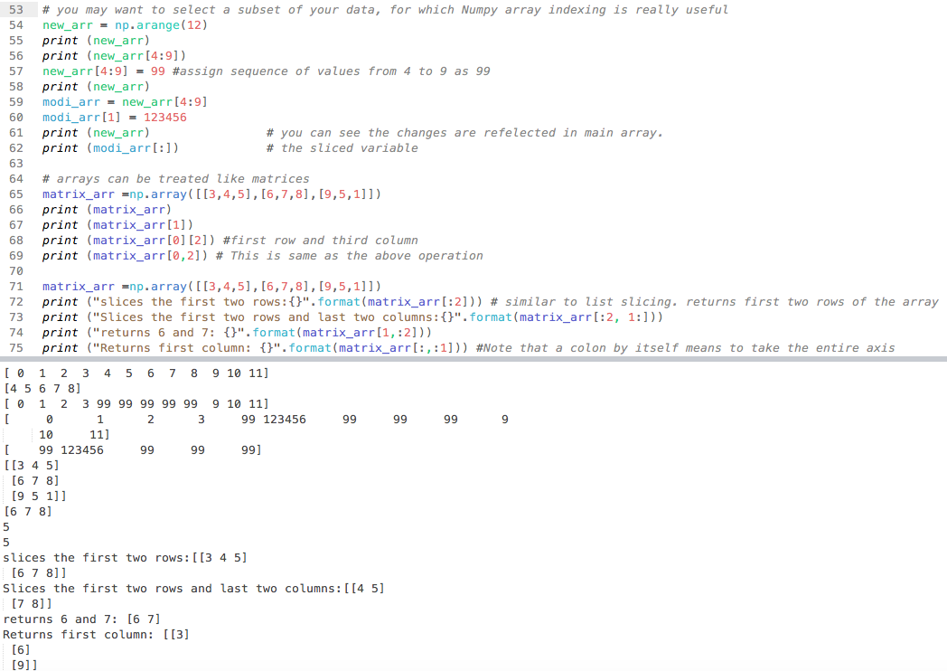

Slide 43
Boolean indexing
# select record for those who had # <= 70 in final
In [265]: gArray[gArray[:, 2]<70,:]
Out[265]:
array([[95, 60, 61],
[82, 89, 61]])
# select record for female students
In [262]: female = [ True, False, True, True, False, True, False, False, False, False]
In [263]: gArray[female, :]
Out[263]:
array([[100, 100, 100],
[ 99, 67, 84],
[ 76, 76, 97],
[ 70, 69, 96]])
# anything < 70 is changed to 70
In [267]: gArray[gArray < 70] = 70
In [268]: gArray
Out[268]:
array([[100, 100, 100],
[ 95, 70, 70],
[ 99, 70, 84],
...,
[ 70, 73, 80],
[ 82, 89, 70],
[ 94, 70, 88]])

Slide 44
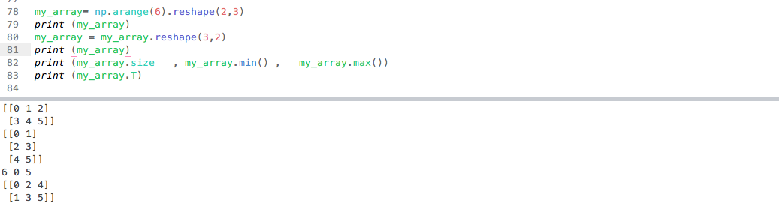
Reshape

Slide 45
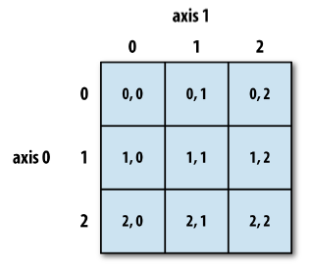
Reshaping and transposing
In [280]: In [77]: np.arange(6).reshape((2,3))
Out[280]:
array([[0, 1, 2],
[3, 4, 5]])
In [281]: In [77]: np.arange(6).reshape((2,3), order='F')
Out[281]:
array([[0, 2, 4],
[1, 3, 5]])
In [290]: np.arange(6).reshape(2,3).T
Out[290]:
array([[0, 3],
[1, 4],
[2, 5]])

Slide 46
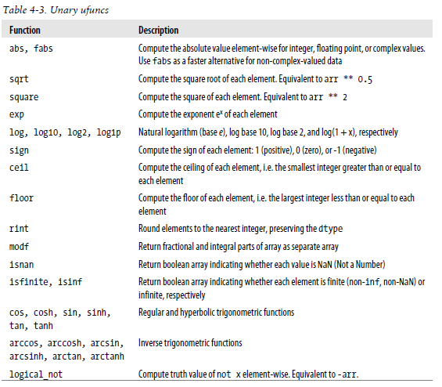
Fast element-wise functions
print (np.sqrt(my_array))

Slide 47
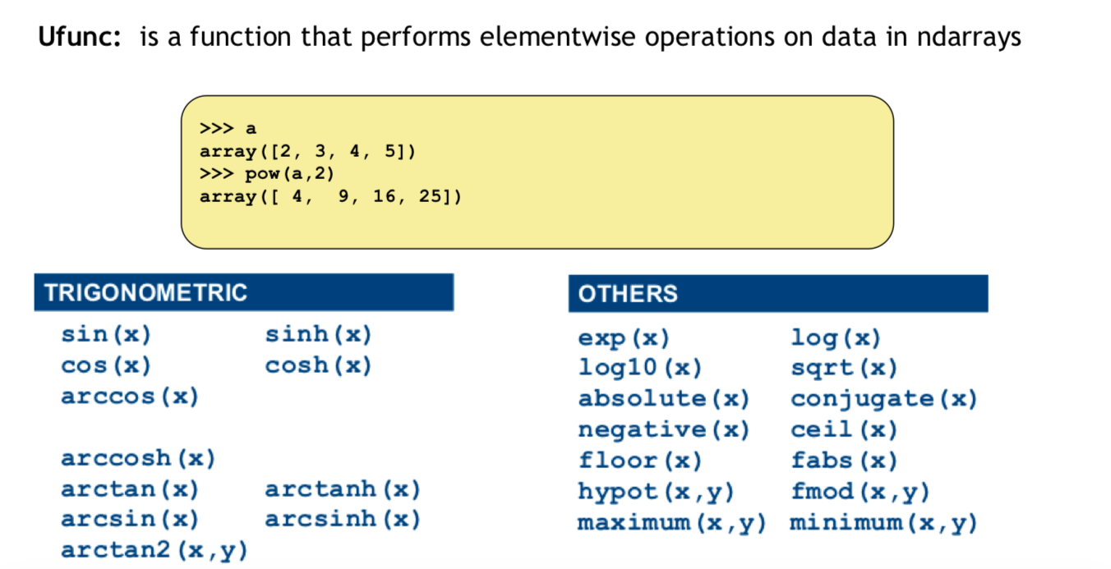

Slide 48
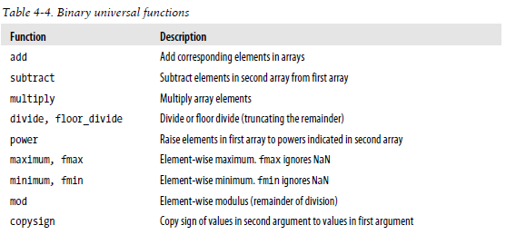
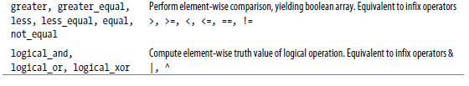
print (np.add(my_array,my_array))
https://docs.scipy.org/doc/numpy/reference/

Slide 49
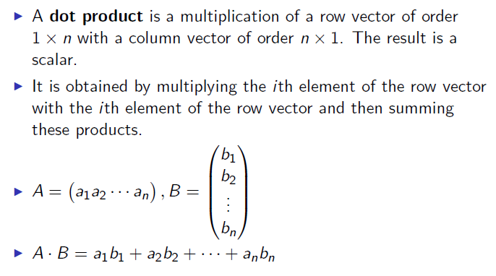
Dot product
In [303]: a = b = np.arange(5)
In [305]: a
Out[305]: array([0, 1, 2, 3, 4])
In [306]: b
Out[306]: array([0, 1, 2, 3, 4])
In [307]: a.dot(b)
Out[307]: 30

Slide 50


Slide 51


Eigenvalues and Eigenvectors

Slide 52
Probability

Slide 53

Rolling a 6-sided dice: The number of possible outcomes = 6 The number of possible events = 2^6= 64
Example event:
to roll 1 or 6
to roll 1 or 2 or 6 …etc

Slide 54


Slide 55


Slide 56


Slide 57


Slide 58

OR. Union

Slide 59


Disjoint

Slide 60


Exhaustive events

Slide 61


Slide 62

The probability that a continuous random variable will assume a particular value is zero.

Slide 63

https://www.youtube.com/watch?v=Fvi9A_tEmXQ

Slide 64



Slide 65



Slide 66

For instance, the probability of a coin flip giving a head is considered a marginal probability because we aren’t considering any other events.

Slide 67



Slide 68
Lets stop for a 5 min and think
Why do we need Probability https://www.youtube.com/watch?v=oeyZNemZe04

Slide 69


Slide 70




Slide 71


Slide 72


Slide 73


Slide 74


Slide 75


Slide 76

https://www.youtube.com/watch?v=HZGCoVF3YvM

Slide 77


Slide 78


Slide 79
Example
ASSUMPTIONS
100 out of 10,000 women aged forty who participate in a routine screening have a cancer.
80 of every 100 women with a cancer will get positive tests
950 out of 9,900 women without a cancer will also get positive tests
PROBLEM
If 10,000 women in this age group undergo a routine screening, about what fraction of women with positive tests will actually have cancer?
EVIDENCE
A woman in this age group had a positive test in a routine screening
PROBLEM
What’s the probability that she has a cancer?
P(A) = 1% of women aged forty who participate in a routine screening has a cancer
P(B|A)= 80% of women with a cancer will get positive tests
9.6% of women without a cancer will also get positive tests
P(B)= proportion of all patients with positive results
P(A|B) = proportion of cancer patients with positive results, within the group of All patients with positive results

Slide 80
Before the screening:
100 out of 10000 women with a cancer
9,900 out of 10000 women without a cancer
After the screening:
A = 80 out of 10000 women with a cancer and positive test
B = 20 out of 10000 women with a cancer and negative test
C = 950 out of 10000 women without a cancer and positive test
D = 8,950 out of 10000 women without a cancer and negative test
All patients that has positive test result = A+C.
Proportion of cancer patients with positive results, within the group of ALL patients with positive results:
A/(A+C) = 80/(80+950) = 80/1030 = 0.078 = 7.8%
Prior Probabilities:
100/10,000 = 1/100 = 1% = p(A)
9,900/10,000 = 99/100 = 99% = p(~A)
Conditional Probabilities:
A = 80/10,000 = (80/100)*(1/100) = p(B|A)*p(A) = 0.008
B = 20/10,000 = (20/100)*(1/100) = p(~B|A)*p(A) = 0.002
C = 950/10,000 = (9.6/100)*(99/100) = p(B|~A)*p(~A) = 0.095
D = 8,950/10,000 = (90.4/100)*(99/100) = p(~B|~A) *p(~A) = 0.895 P(B) = (80/10000 + 950/10000)
Rate of cancer patients with positive results, within the group of ALL patients with positive results:
P(A|B) = P(B|A) * P(A)/ P(B) = 0.008/(0.008+0.095) = 0.008/0.103 = 0.078 = 7.8%

Slide 81
Likelihood vs prob
https://www.youtube.com/watch?v=pYxNSUDSFH4

Slide 82
There is more, but we have to change the subject
Watch this later: https://www.youtube.com/watch?v=R13BD8qKeTg

Slide 83
basic statistics

Slide 84
Why study statistics?
Data are everywhere
Statistical techniques are used to make many decisions that affect our lives
No matter what your career, you will make professional decisions that involve data. An understanding of statistical methods will help you make these decisions efectively
https://www.youtube.com/watch?v=MXaJ7sa7q-8&list=PL0KQuRyPJoe6KjlUM6iNYgt8d0DwI-IGR

Slide 85
What Is Statistics?
Collecting Data
e.g., Survey
Presenting Data
e.g., Charts & Tables
Characterizing Data
e.g., Average
Data Analysis
Why?
© 1984-1994 T/Maker Co.
Decision- Making
© 1984-1994 T/Maker Co.
Notes:
:1, 1, 3

Slide 86
Statistics
The science of collectiong, organizing, presenting, analyzing, and interpreting data to assist in making more effective decisions
Statistical analysis – used to manipulate summarize, and investigate data, so that useful decision-making information results.

Slide 87
Application Areas
Economics
Forecasting
Demographics
Sports
Individual & Team Performance
Engineering
Construction
Materials
Business
Consumer Preferences
Financial Trends

Slide 88
Two areas of statistics:
Descriptive Statistics: collection, presentation, and description of sample data.
Inferential Statistics: making decisions and drawing conclusions about populations.

Slide 89
Descriptive Statistics
Involves
Collecting Data
Presenting Data
Characterizing Data
Purpose
Describe Data
$
50
25
0
Q1
Q2
Q3
Q4
‾X = 30.5 S² = 113

Slide 90
Inferential Statistics
Involves
Estimation
Hypothesis Testing
Purpose
Make decisions about population characteristics
Population?

Slide 91
Types of Statistics/Analyses
Descriptive Statistics
Describing a phenomena
Frequencies
Basic measurements
Inferential Statistics
Hypothesis Testing
Correlation
Confidence Intervals
Significance Testing
Prediction
How many? How much?
BP, HR, BMI, IQ, etc.
Inferences about a phenomena
Proving or disproving theories
Associations between phenomena
If sample relates to the larger population
E.g., Diet and health

Slide 92
INFERENTIAL STATISTICS
Inferential statistics can be used to prove or disprove theories, determine associations between variables, and determine if findings are significant and whether or not we can generalize from our sample to the entire population
The types of inferential statistics :
Correlation
T-tests/ANOVA
Chi-square
Logistic Regression

Slide 93
Inferential Statistics
Estimation
e.g., Estimate the population mean weight using the sample mean weight
Hypothesis testing
e.g., Test the claim that the population mean weight is 70 kg
Inference is the process of drawing conclusions or making decisions about a population based on sample results

Slide 94

Introduction to Basic Terms
Population: A collection, or set, of individuals or objects or events whose properties are to be analyzed.
Sample: A subset of the population.
Statistical inference is the process of using data obtained from a sample to make estimates and test hypotheses about the characteristics of a population

Slide 95
Process of Statistical Inference: example
1. Population
consists of heights of
all JUST students.
2. A sample of 25
students are randomly
selected and measured.
4. The sample average
is used to estimate the
population average.
3. The sample data
provide a sample
average height
of 5’ 5’’.

Slide 96
Sampling methods
Sampling methods can be:
random (each member of the population has an equal chance of being selected)
nonrandom
The actual process of sampling causes sampling errors. For example, the sample may not be large enough or representative of the population.

Slide 97
Back to Basic Terms
Variable: A characteristic about each individual element of a population or sample.
Data (singular): The value of the variable associated with one element of a population or sample. This value may be a number, a word, or a symbol.
Data (plural): The set of values collected for the variable from each of the elements belonging to the sample.
Statistic: A numerical value summarizing the sample data.

Slide 98
Example: A college dean is interested in learning about the average age of faculty. Identify the basic terms in this situation.
The population is the age of all faculty members at the college.
A sample is any subset of that population. For example, we might select 10 faculty members and determine their age.
The variable is the “age” of each faculty member.
One data would be the age of a specific faculty member.
The data would be the set of values in the sample.
The statistic is the “average” age for all faculty in the sample.

Slide 99
Two kinds of variables:
Qualitative, or Attribute, or Categorical, Variable: A variable that categorizes or describes an element of a population (hair color, Department).
Quantitative, or Numerical, Variable: A variable that quantifies an element of a population (height and weight, number of children in a family).

Slide 100
Qualitative data
Qualitative data are generally described by words or letters. They are not as widely used as quantitative data because many numerical techniques do not apply to the qualitative data. For example, it does not make sense to find an average hair color or blood type.

Slide 101
Quantitative data
Quantitative data are always numbers and are the result of counting or measuring attributes of a population. Quantitative data can be separated into two subgroups:
discrete (if it is the result of counting (the number of students of a given ethnic group in a class, the number of books on a shelf, ...)
continuous (if it is the result of measuring (distance traveled, weight of luggage, …)

Slide 102
Qualitative and Quantitative Data
Example:
The grade point averages of five students are listed in the table. Which data are qualitative data and which are quantitative data?
Student | GPA
Sally | 3.22
Bob | 3.98
Cindy | 2.75
Mark | 2.24
Kathy | 3.84
Qualitative data
Quantitative data

Slide 103
Qualitative and quantitative variables may be further subdivided:
Nominal
Qualitative
Ordinal
Variable
Discrete
Quantitative
Continuous

Slide 104
Nominal Variable: A qualitative variable that categorizes (or describes, or names) an element of a population (hair color).
Ordinal Variable: A qualitative variable that incorporates an ordered position, or ranking (level of happiness).
Discrete Variable: A quantitative variable that can assume a countable number of values (number of students in each class).
Continuous Variable: A quantitative variable that can assume an uncountable number of values. Intuitively, a continuous variable can assume any value along a line interval, including every possible value between any two values (salary of an employee).

Slide 105
Note:
1. In many cases, a discrete and continuous variable may be distinguished by determining whether the variables are related to a count or a measurement.
Discrete variables are usually associated with counting.
Continuous variables are usually associated with measurements. The values of discrete variables are only limited by your ability to measure them.

Slide 106
Example: Identify each of the following as examples of (1) nominal, (2) ordinal, (3) discrete, or (4) continuous variables:
1. The length of time until a pain reliever begins to work.
2. The number of chocolate chips in a cookie.
3. The number of colors used in a statistics textbook.
4. The brand of refrigerator in a home.
5. The overall satisfaction rating of a new car.
6. The number of files on a computer’s hard disk.
7. The pH level of the water in a swimming pool.
8. The number of staples in a stapler.

Slide 107
Descriptive Statistics
Types of descriptive statistics:
Organize Data
Tables
Graphs
Summarize Data
Central Tendency
Variation

Slide 108
Descriptive Statistics
Summarizing Data:
Central Tendency (or Groups’ “Middle Values”)
Mean
Median
Mode
Variation (or Summary of Differences Within Groups)
Range
Interquartile Range
Variance
Standard Deviation

Slide 109
Mean
Most commonly called the “average.”
Add up the values for each case and divide by the total number of cases.
Y-bar = (Y1 + Y2 + . . . + Yn)
n
Y-bar = Σ Yi
n

Slide 110
Mean
Class A--IQs of 13 Students
102 115
128 109
131 89
98 106
140 119
93 97
110
Class B--IQs of 13 Students
127 162
131 103
96 111
80 109
93 87
120 105
109
Σ Yi = 1437 Σ Yi = 1433
Y-bar_{A} = Σ Yi = 1437 = 110.54 Y-bar_{B} = Σ Yi = 1433 = 110.23
n 13 n 13

Slide 111
Mean
Means can be badly affected by outliers (data points with extreme values unlike the rest)
Outliers can make the mean a bad measure of central tendency or common experience
Income in the U.S.
Bill Gates
All of Us
Mean
Outlier

Slide 112
Median
The middle value when a variable’s values are ranked in order; the point that divides a distribution into two equal halves.
When data are listed in order, the median is the point at which 50% of the cases are above and 50% below it.
The 50th percentile.

Slide 113
Median
Class A--IQs of 13 Students
89
93
97
98
102
106
109
110
115
119
128
131 140
Median = 109
(six cases above, six below)

Slide 114
Median
If the first student were to drop out of Class A, there would be a new median:
89
93
97
98
102
106
109
110
115
119
128
131
140
Median = 109.5
109 + 110 = 219/2 = 109.5
(six cases above, six below)

Slide 115
Median
The median is unaffected by outliers, making it a better measure of central tendency, better describing the “typical person” than the mean when data are skewed.
All of Us
Bill Gates
outlier

Slide 116
Median
If the recorded values for a variable form a symmetric distribution, the median and mean are identical.
In skewed data, the mean lies further toward the skew than the median.
Symmetric
Skewed
Mean
Mean
Median
Median

Slide 117
Mode
The most common data point is called the mode.
The combined IQ scores for Classes A & B:
80 87 89 93 93 96 97 98 102 103 105 106 109 109 109 110 111 115 119 120
127 128 131 131 140 162
BTW, It is possible to have more than one mode!
A la mode!!

Slide 118
Mode
It may give you the most likely experience rather than the “typical” or “central” experience.
In symmetric distributions, the mean, median, and mode are the same.
In skewed data, the mean and median lie further toward the skew than the mode.
Symmetric
Skewed
Mean
Median
Mode
Mode
Median
Mean

Slide 119
Descriptive Statistics
Summarizing Data:
Central Tendency (or Groups’ “Middle Values”)
Mean
Median
Mode
https://repl.it/@DrMalak/CentralTendencies
Variation (or Summary of Differences Within Groups)
Range
Interquartile Range
Variance
Standard Deviation

Slide 120
Range
The spread, or the distance, between the lowest and highest values of a variable.
To get the range for a variable, you subtract its lowest value from its highest value.
Class A--IQs of 13 Students
102 115
128 109
131 89
98 106
140 119
93 97
110
Class A Range = 140 - 89 = 51
Class B--IQs of 13 Students
127 162
131 103
96 111
80 109
93 87
120 105
109
Class B Range = 162 - 80 = 82

Slide 121
Variance
A measure of the spread of the recorded values on a variable. A measure of dispersion.
The larger the variance, the further the individual cases are from the mean.
The smaller the variance, the closer the individual scores are to the mean.
Mean
Mean

Slide 122
Variance
Variance is a number that at first seems complex to calculate.
Calculating variance starts with a “deviation.”
A deviation is the distance away from the mean of a case’s score.
Yi – Y-bar
If the average person’s car costs $20,000, my deviation from the mean is - $14,000!
6K - 20K = -14K

Slide 123
Variance
The deviation of 102 from 110.54 is? Deviation of 115?
102 - 110.54 = -8.54 115 - 110.54 = 4.46
Class A--IQs of 13 Students
102 115
128 109
131 89
98 106
140 119
93 97
110
Y-bar_{A} = 110.54

Slide 124
Variance
We want to add these to get total deviations, but if we were to do that, we would get zero every time. Why?
We need a way to eliminate negative signs.
Squaring the deviations will eliminate negative signs...
A Deviation Squared: (Yi – Y-bar)²
Back to the IQ example,
A deviation squared for 102 is: of 115:
(102 - 110.54)² = (-8.54)² ⁼ 72.93 (115 - 110.54)² = (4.46)² = 19.89

Slide 125
Variance
If you were to add all the squared deviations together, you’d get what we call the
“Sum of Squares.”
Sum of Squares (SS) = Σ (Yi – Y-bar)²
SS = (Y1 – Y-bar)² + (Y2 – Y-bar)² + . . . + (Yn – Y-bar)²

Slide 126
Variance
Class A, sum of squares:
(102 – 110.54)² + (115 – 110.54)² +
(126 – 110.54)² + (109 – 110.54)² +
(131 – 110.54)² + (89 – 110.54)² +
(98 – 110.54)² + (106 – 110.54)² +
(140 – 110.54)² + (119 – 110.54)² +
(93 – 110.54)² + (97 – 110.54)² +
(110 – 110.54) = SS = 2825.39
Class A--IQs of 13 Students
102 115
128 109
131 89
98 106
140 119
93 97
110
Y-bar = 110.54

Slide 127
Variance
The last step…
The approximate average sum of squares is the variance.
SS/N = Variance for a population.
SS/n-1 = Variance for a sample.
Variance = Σ(Yi – Y-bar)² / n – 1
The reason dividing by n-1 corrects the bias is because we are using the sample mean, instead of the population mean, to calculate the variance. Since the sample mean is based on the data, it will get drawn toward the center of mass for the data.

Slide 128
Variance
For Class A, Variance = 2825.39 / n - 1
= 2825.39 / 12 = 235.45
How helpful is that???

Slide 129
Standard Deviation
To convert variance into something of meaning, let’s create standard deviation.
The square root of the variance reveals the average deviation of the observations from the mean.
s.d. = Σ(Yi – Y-bar)²
n - 1

Slide 130
Standard Deviation
For Class A, the standard deviation is:
235.45 = 15.34
The average of persons’ deviation from the mean IQ of 110.54 is 15.34 IQ points.
Review:
1. Deviation
2. Deviation squared
3. Sum of squares
4. Variance
5. Standard deviation

Slide 131
Standard Deviation
Larger s.d. = greater amounts of variation around the mean.
For example:
19 25 31 13 25 37
Y = 25 Y = 25
s.d. = 3 s.d. = 6
s.d. = 0 only when all values are the same (only when you have a constant and not a “variable”)
If you were to “rescale” a variable, the s.d. would change by the same magnitude—if we changed units above so the mean equaled 250, the s.d. on the left would be 30, and on the right, 60
Like the mean, the s.d. will be inflated by an outlier case value.

Slide 132


The rule of 68-95-99.7

Slide 133

Statistical Computer Packages
Typical Software
SPSS
MINITAB
Excel
Need Statistical Understanding
Assumptions
Limitations

Slide 134
Box-Plots
A way to graphically portray almost all the descriptive statistics at once is the box-plot.
A box-plot shows: Upper and lower quartiles
Mean
Median
Range
Outliers (1.5 IQR)
https://www.youtube.com/watch?v=tpToLyZibKM&list=PL0KQuRyPJoe6KjlUM6iNYgt8d0DwI-IGR&index=6

Slide 135

A boxplot is a standardized way of displaying the distribution of data based on a five number summary (“minimum”, first quartile (Q1), median, third quartile (Q3), and “maximum”). It can tell you about your outliers and what their values are. It can also tell you if your data is symmetrical, how tightly your data is grouped, and if and how your data is skewed.

Slide 136
Box-Plots
IQR = 27; There is no outlier.
162
123.5
M=110.5
106.5
96.5
82

Slide 137

Interquartile Range
A quartile is the value that marks one of the divisions that breaks a series of values into four equal parts.
The median is a quartile and divides the cases in half.
25th percentile is a quartile that divides the first ¼ of cases from the latter ¾.
75th percentile is a quartile that divides the first ¾ of cases from the latter ¼.
The interquartile range is the distance or range between the 25th percentile and the 75th percentile. Below, what is the interquartile range?
25%
25%
25% of cases
25% of cases
0 250 500 750 1000

Slide 138
Correlation
A correlation coefficient is a statistical measure of the degree to which changes to the value of one variable predict change to the value of another.
When to use it?
When you want to know about the association or relationship between two continuous variables
Ex) Taller people tend to be heavier.
If an increase in one variable tends to be associated with a decrease in the other then this is known as a negative correlation. An example would be height above sea level and temperature
What does it tell you?
If a linear relationship exists between two variables, and how strong that relationship is
What do the results look like?
The correlation coefficient = Pearson’s r
Ranges from -1 to +1

Slide 139

Correlation
https://www.youtube.com/watch?v=DAH8DyLXdjM&list=PL0KQuRyPJoe6KjlUM6iNYgt8d0DwI-IGR&index=9
Guide for interpreting strength of correlations:
0 – 0.25 = Little or no relationship
0.25 – 0.50 = Fair degree of relationship
0.50 - 0.75 = Moderate degree of relationship
0.75 – 1.0 = Strong relationship
1.0 = perfect correlation

Slide 140
Correlation
How do you interpret it?
If r is positive, high values of one variable are associated with high values of the other variable (both go in SAME direction - ↑↑ OR ↓↓)
Ex) Diastolic blood pressure tends to rise with age, thus the two variables are positively correlated
If r is negative, low values of one variable are associated with high values of the other variable (opposite direction - ↑↓ OR ↓ ↑)
Ex) Heart rate tends to be lower in persons who exercise frequently, the two variables correlate negatively
Correlation of 0 indicates NO linear relationship
How do you report it?
“Diastolic blood pressure was positively correlated with age (r = .75, p < . 05).”
Tip: Correlation does NOT equal causation!!! Just because two variables are highly correlated, this does NOT mean that one CAUSES the other!!!

Slide 141
Examples
Positive
The more time you spend running on a treadmill, the more calories you will burn.
As the temperature goes up, ice cream sales also go up.
As a student's study time increases, so does his test average.
Negative
A student who has many absences has a decrease in grades.
As one exercises more, his body weight becomes less.

